Slide 1
Ellipses
{Textbook pages 664-675}
Nicky Wojtania, Khushali Roy, Angela Yang

Slide 2
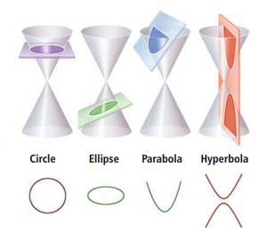
What is a conic section?
Conic sections are curves that result from the intersection of a double right cone and a plane.
The general equation of a conic section is:
Ax² + Cy² + Dx + Ey + F = 0
If AC = 0, the conic section is a parabola. If AC > 0, the conic section is an ellipse or circle, If AC < 0, the conic section is a hyperbola.

Slide 3
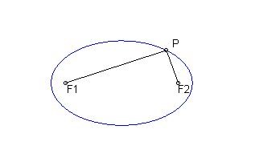
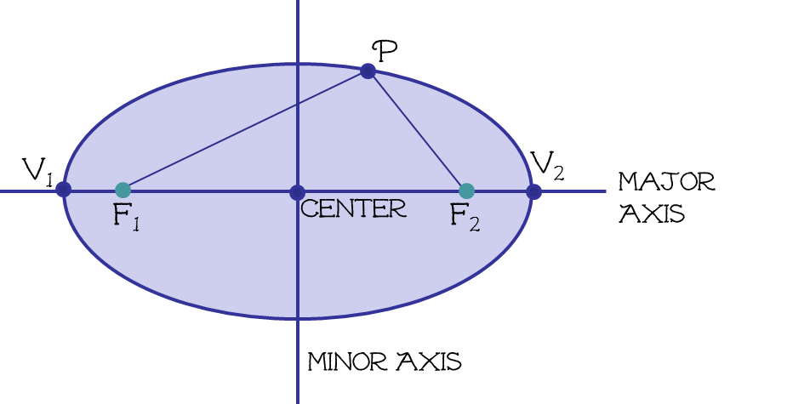
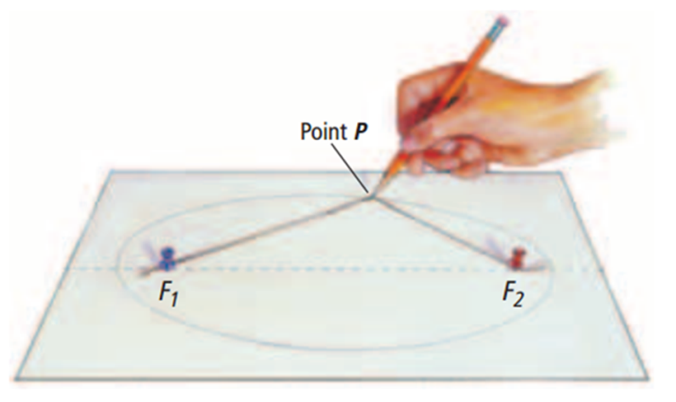
What is an ellipse?
An ellipse is the collection of all points in the same plane, the sum of whose distance from two fixed points, called the foci, is a constant.

Slide 4
Terms to define
Major Axis –
The line containing the foci (the longer axis)
Vertices of the ellipse –
The endpoints of the major axis
Minor Axis –
The line through the center and perpendicular to the major axis (the shorter axis)
Co-vertices of the ellipse –
The endpoints of the minor axis

Slide 5
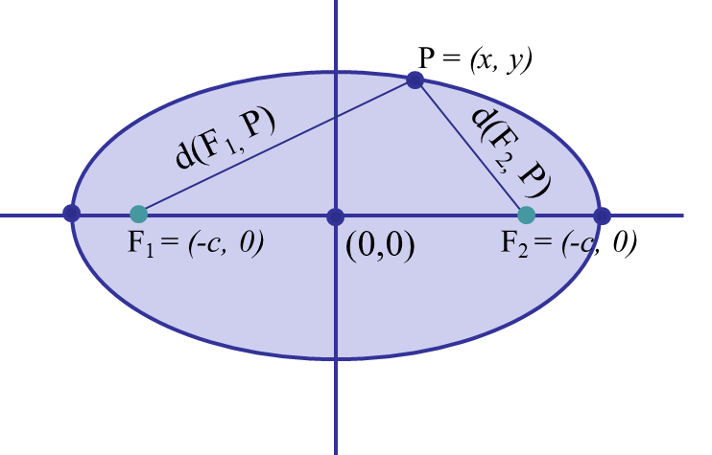
Working with ellipses with a center at the origin
d(F₁, P) + d(F₂, P) =2a
a = the distance of half of the major axis
b = the distance of half of the minor axis
c = the distance from the origin to the foci
Proof:
Let point P = (c, 0)
d (F₁, P) = a + c
d (F₂, P) = a – c
d (F₁, P) + d (F₂, P) = a + c + a – c = 2a

Slide 6
(0, b)
a
b
V₁ = (-a, 0)
c
V₂ = (a, 0)
F₁ = (-c, 0)
(0,0)
F₂ = (-c, 0)
(0, -b)

Slide 7
P = (x, y)
y
c
c-x
(-c, 0)
x
(-c, 0)

Slide 8
Ellipses with the y-axis as the major axis
y
V₁ = (0, a)
F₁ = (c, 0)
a
c
(-b,0)
b
(b,0)
x
F₂ = (-c, 0)
V₁ = (0, -a)

Slide 9
Practice
Find an equation of an ellipse with the center at the origin, one focus at (4, 0) and a vertex at (-5, 0).
(3, 0)
(-5, 0)
(-4, 0)
(0,0)
(5, 0)
(4, 0)
(-3, 0)

Slide 10
Ellipses with a center at
(h, k)
Transformations:
To transform to the left, you subtract from the x value.
To transform to the right, you add to the x value.
To transform up, you subtract from the y value.
To transform down, you add from the y value.

Slide 11
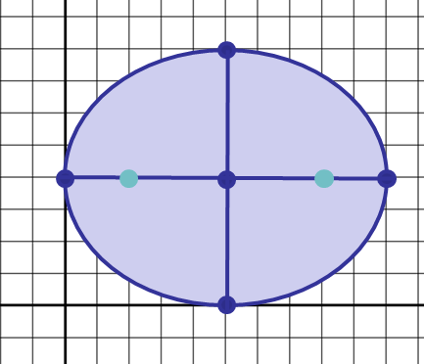
Practice
Find the equation of an ellipse with the center at (5, 4), one focus at (8, 4), and one vertex at (10, 4). Graph the equation.
(5, 8)
$$\frac{{(x−5)}^{2}}{25}+\frac{{(y−4)}^{2}}{16}=1$$
V₁ = (0, 4)
F₁ = (2, 4)
F₂ = (8, 4)
V₂ = (10, 4)
x
(5, 0)
y

Slide 12
Ellipses in Parametric Form
r
(x, y)
Ɵ
(0, 0)
r
(x, y)
Ɵ
(h, k)

Slide 13
Ellipses in Parametric Form
b – radius along y-axis
(0,0)
a – radius along x-axis
b – radius along y-axis
k + bsint = t(y)
k + acost = t(x)
(h,k)
a – radius along x-axis

Slide 14
Ellipses in Parametric Form
b – radius along y-axis
(h,k)
a – radius along x-axis

Slide 15
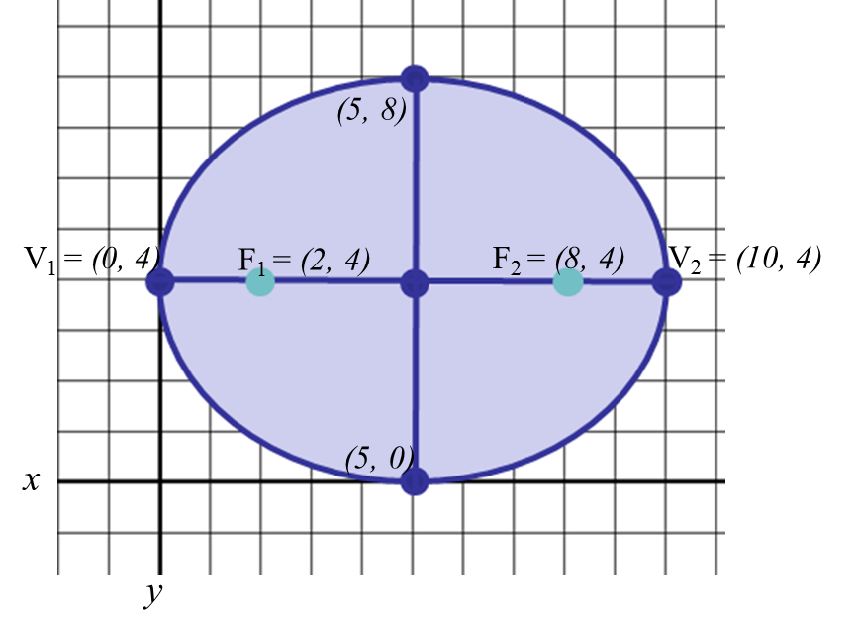
Practice
Find the equation of an ellipse in parametric form with the center at (5, 4), one focus at (8, 4), and one vertex at (10, 4). Graph the equation.
$$\frac{{(x−5)}^{2}}{25}+\frac{{(y−4)}^{2}}{16}=1$$
(h,k) = (5,4)
a = 5
b = 4
c = 3
5 + 5sint = t(y)
4 + 4sint = t(x)

Slide 16
Eccentricity

Slide 17
Directrix – a fixed line; in the case of the ellipse, the directrix is parallel to the minor axis and perpendicular to the major axis
Pole O
Directrix D
d(D,P)
P = (r, Ɵ)
r
Ɵ
Q
Polar axis
p
O, Focus F
p – distance from minor axis to directrix

Slide 18
directrices

Slide 19
Practice
Identify the conic section, find the eccentricity and the directrix:
$$r= \frac{9}{6+2cosθ}$$

Slide 20
Practice
Sketch the following conic section:
$$r= \frac{9}{6+2cosθ}$$
0

